Slide 1
Applying for an
Academic Scholarship
Mat-Su Health Foundation 2024-25 Scholarship Season

Slide 2
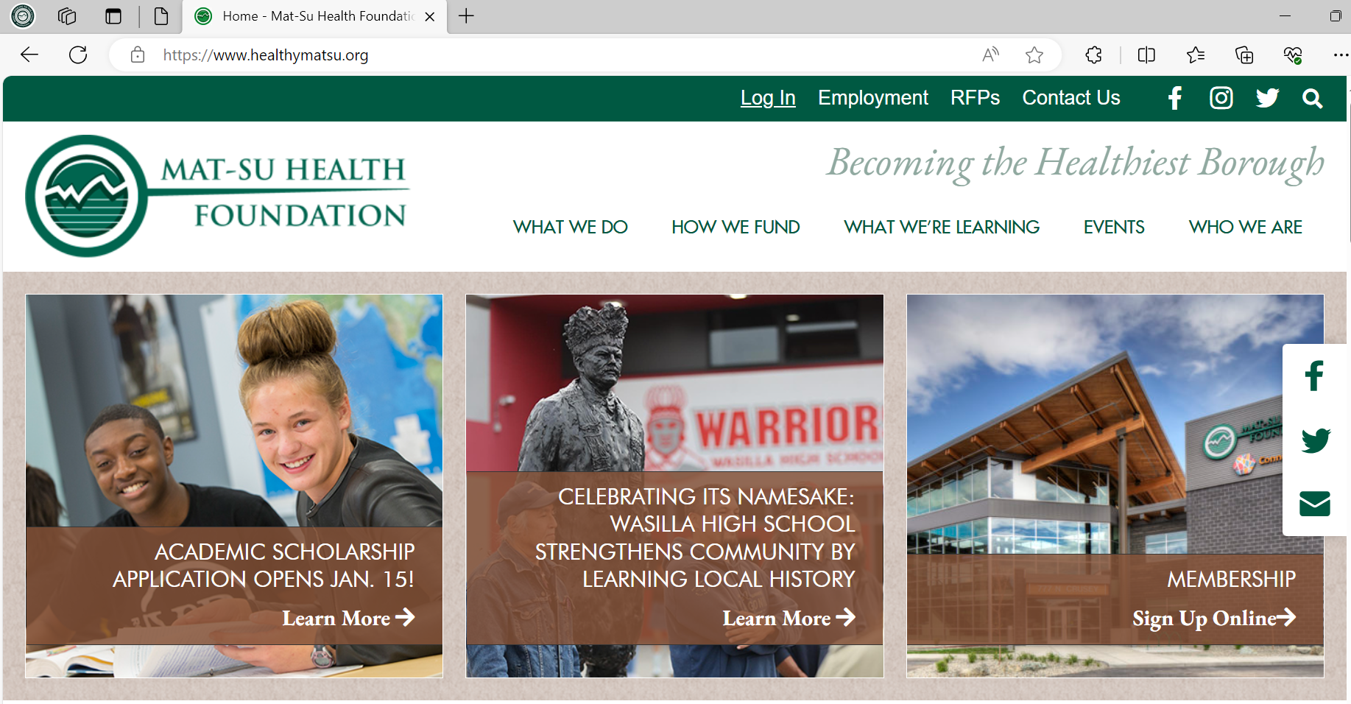
Step #1 - Visit https://www.healthymatsu.org/

Slide 3
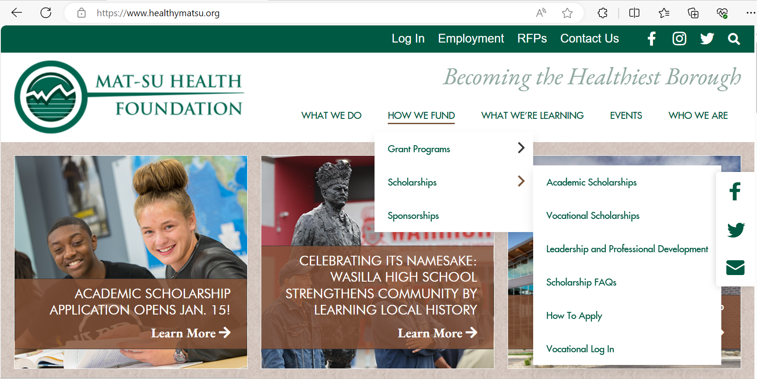
Step #2 - Select “How We Fund” > “Scholarships” > “Academic Scholarships”

Slide 4
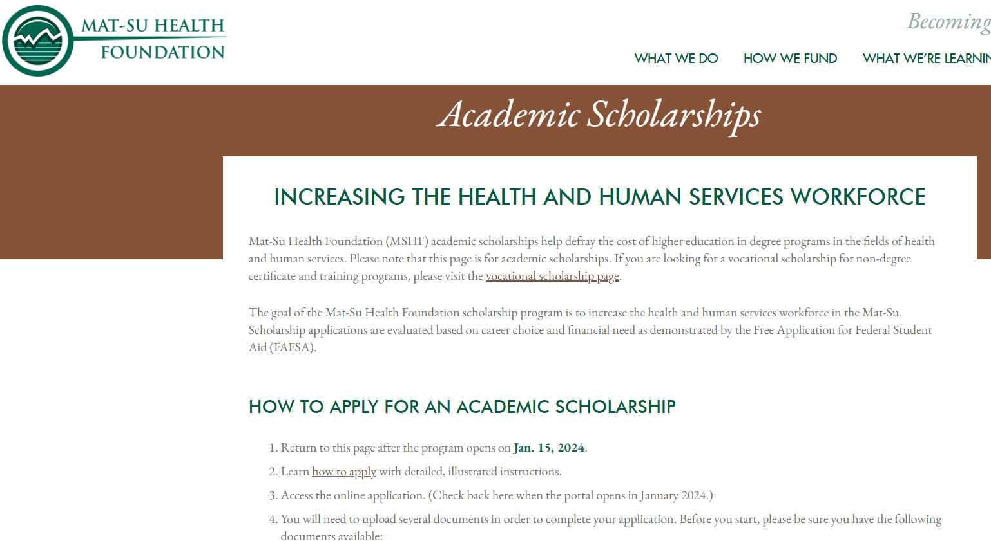
Step #3 - After carefully reading the “Academic Scholarships” landing page, click on the apply link (coming soon)
Once we make the application link available, you will find it in this area. Please read this page carefully.

Slide 5
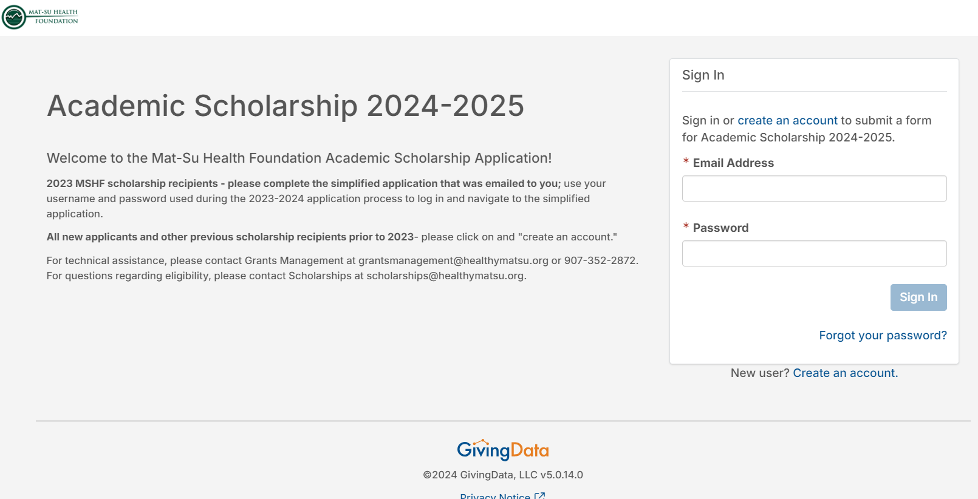
Step #4 - Click on the “Create an Account” link

Slide 6
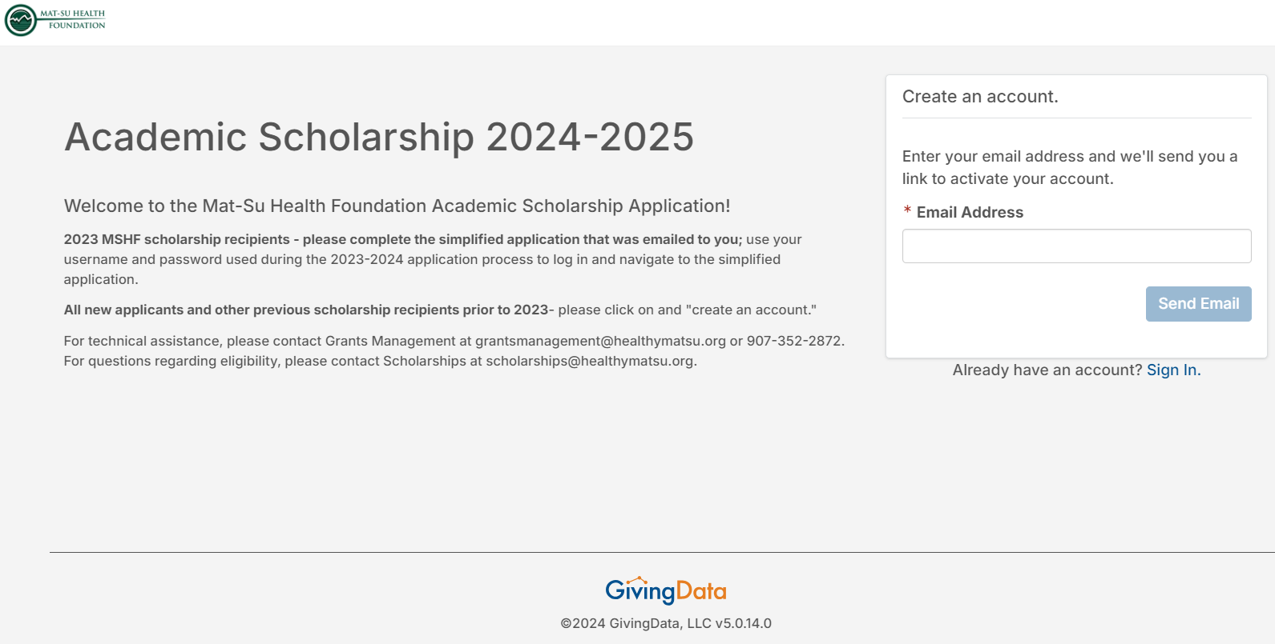
Step #5 – Account activation. Enter the email address you will use for the academic scholarship application process and click “Send Email.”

Slide 7
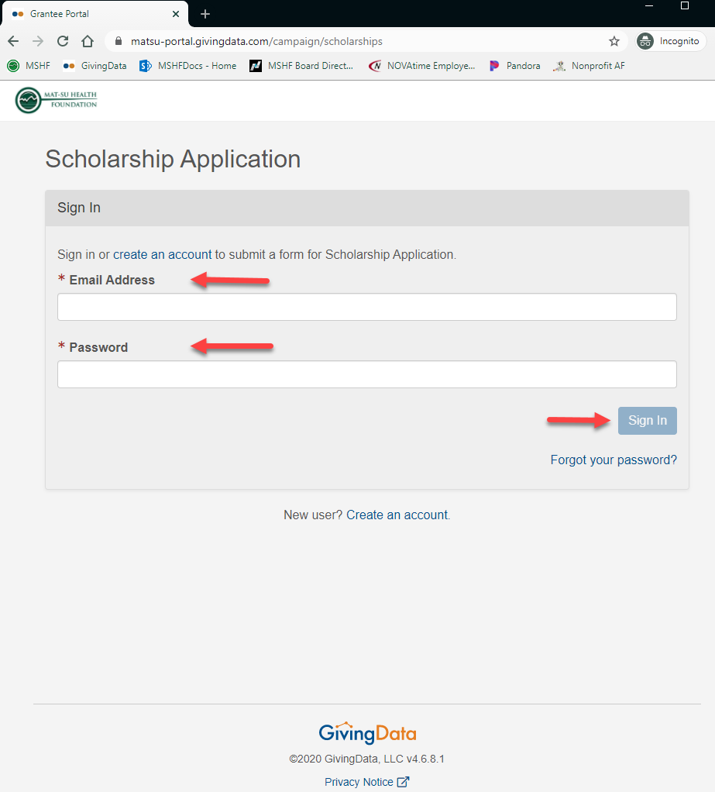
Step #6 - Check your email account for the link to activate your account. Click the link you receive and then enter your email and create your own password.
Tip: Keep careful track of your email & password

Slide 8
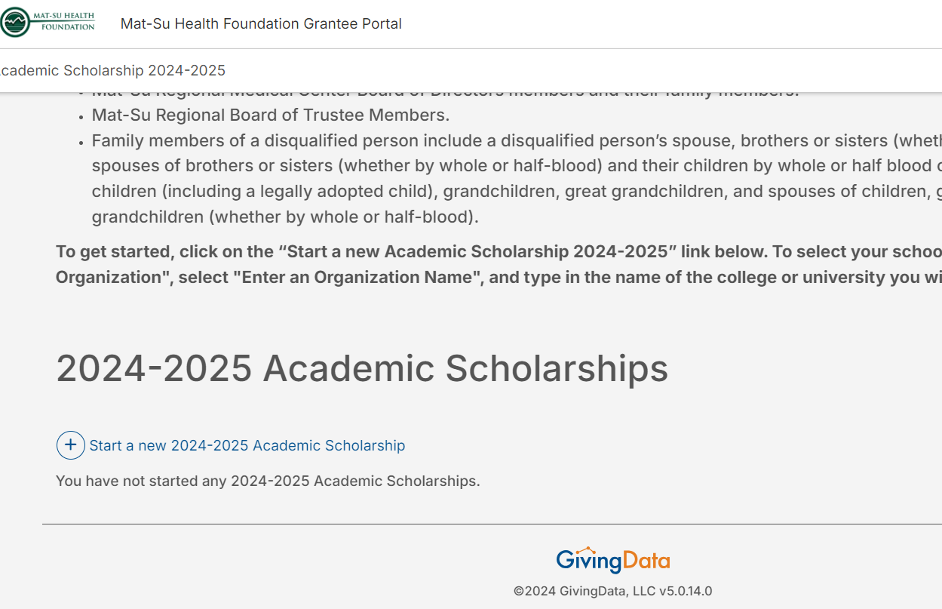
Step #7 - Once you have logged in, scroll to the bottom of the page and click the blue “Start a new 2024-2025 Academic Scholarship” link

Slide 9
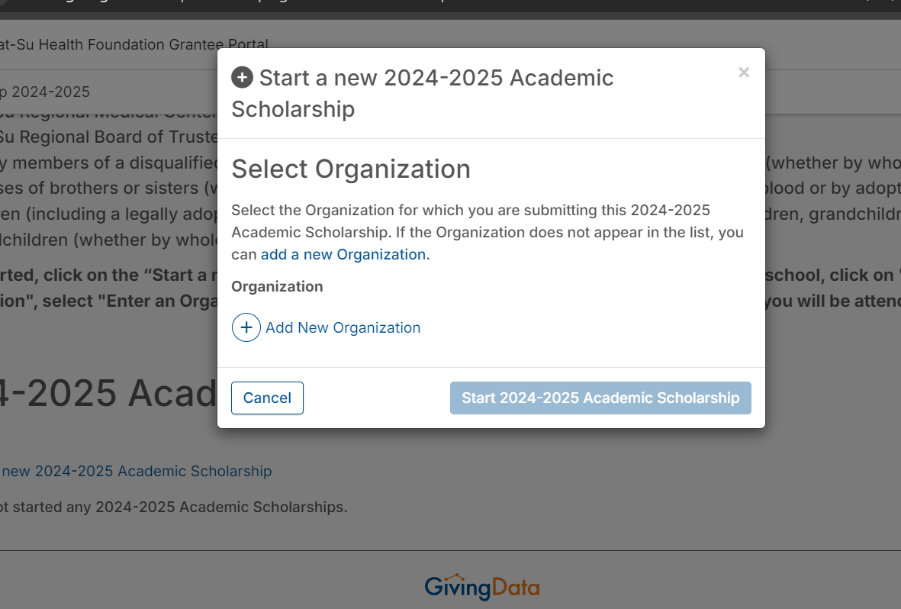
Step #8 – Select add new organization (the school you are attending)

Slide 10
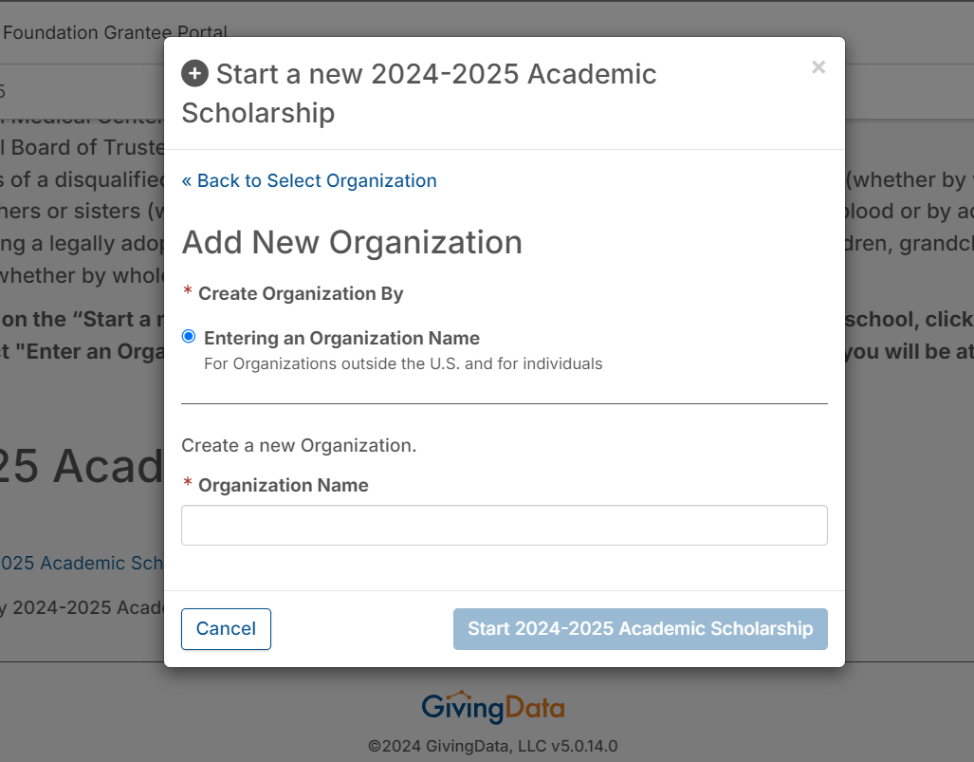
Step #9 – Enter your school’s name and click on the
“Start 2024-2025 Academic Scholarship” button

Slide 11
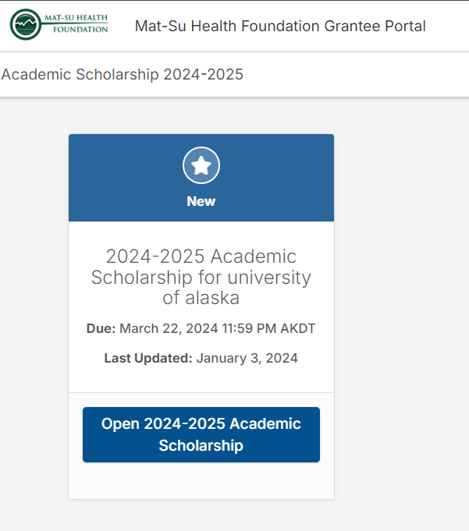
Step #10 – Scroll to the bottom of the page.
Now you’re ready to start your academic scholarship application

Slide 12
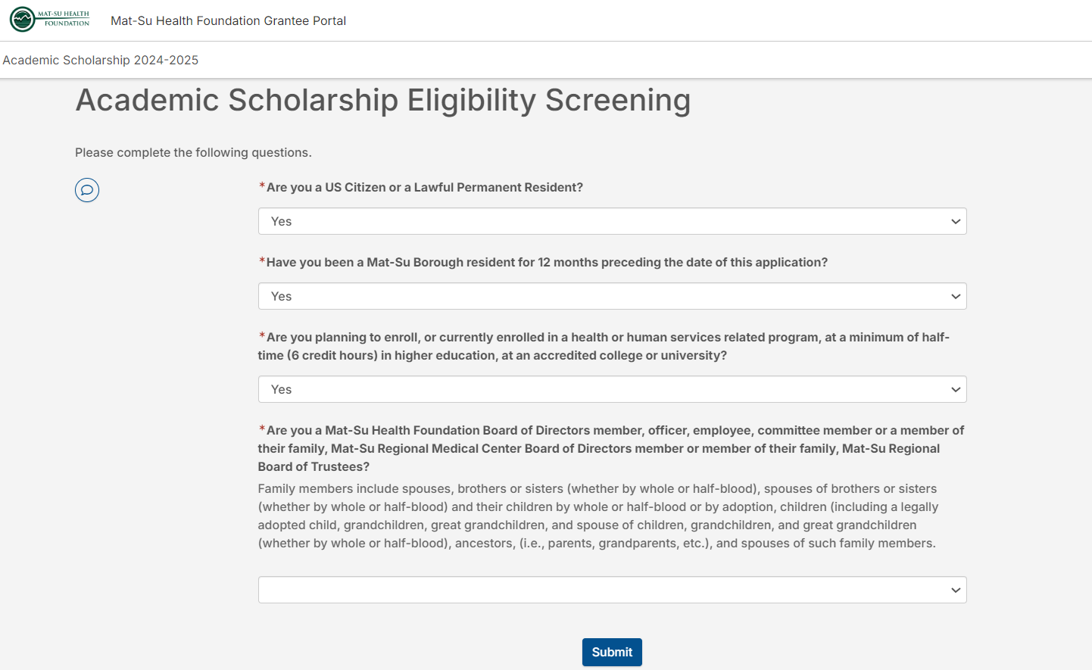
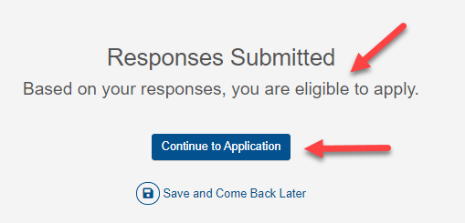
Step #11 - Eligibility Screening - Complete all the questions and then click “Submit”
Those eligible will be able to continue to the application.
If ineligible, please contact us with questions and inquiries at
scholarships@healthymatsu.org

Slide 13
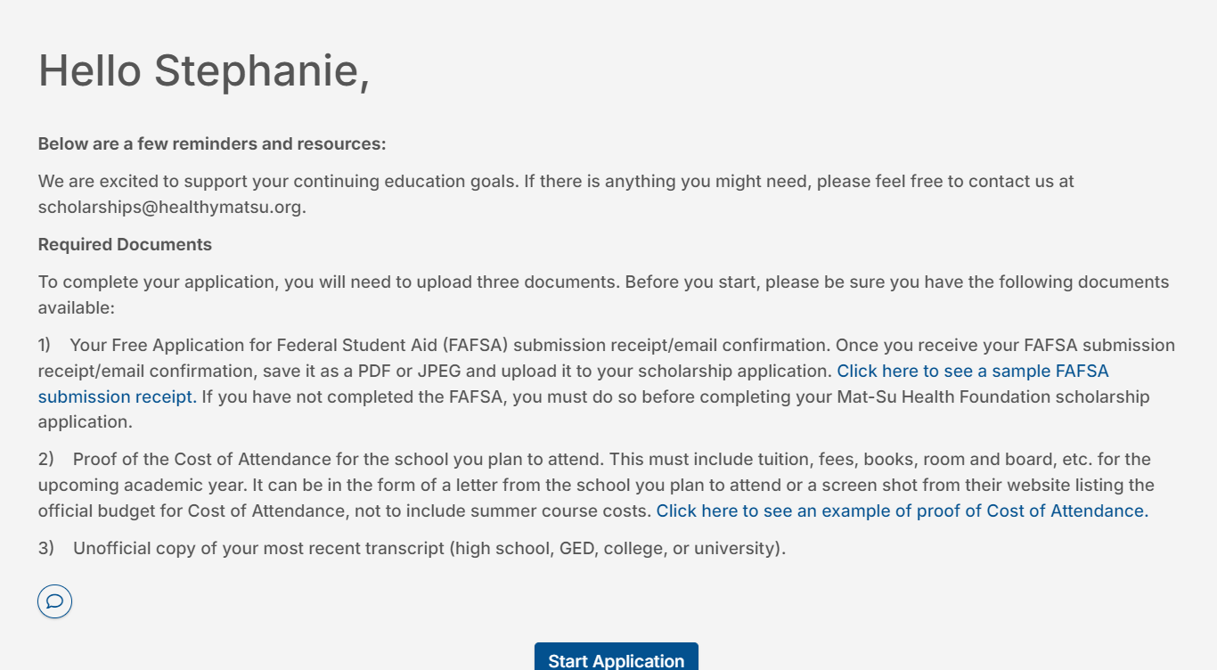
Before You Begin
Required Documents:
FAFSA
Cost of Attendance
Unofficial Transcript
You can save your application and come back to it if needed

Slide 14
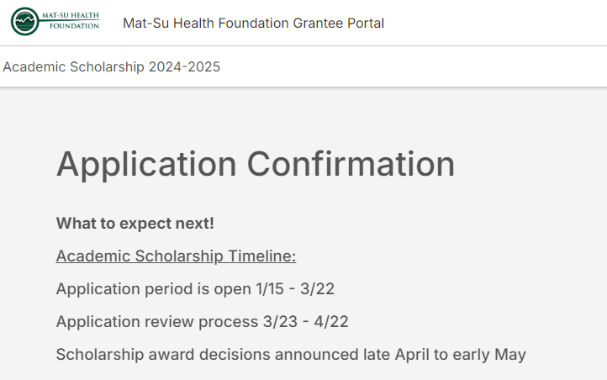

Slide 15
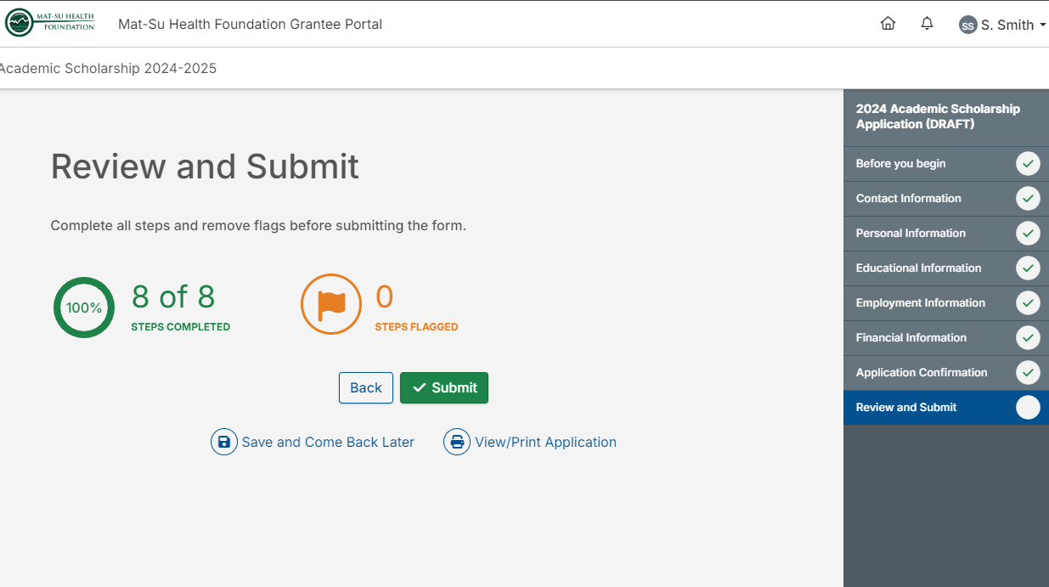
Final Step – Review & submit! You’ll know when each stage is complete when you see a green check mark in the circle. Finally, click the green “Submit” button.

